Slide 1
Customer Retention Model
A tool that make your customer loyal to your business

Slide 2
The problem statement
What are the key factor which helps in figure out:
How to make more effective product and marketing decisions
Discern which features impact retention
How long customers usually stick around
Service quality, system quality, information quality, trust and net benefit

Slide 3
Our solutioning …..
Understanding the data
Analyze the relationship between the features

Slide 4
Achieved using exploratory data analysis ……..
Univariate analysis
Bivariate analysis
Multivariate analysis
Missing value analysis
Outlier detection analysis
The correlation matrix
Data Shape analysis
Dataset Features analysis

Slide 5
Approach followed………
Pandas: Data analysis and manipulation tool
NumPy: Provide support for mathematical functions, random number etc
Matplotlib: is a low-level graph plotting library in python that serves as a visualization
Seaborn: is a library mostly used for statistical plotting in python
Scikit-Learn: is an open-source Python library that has powerful tools for data analysis and data mining

Slide 6
Exploratory Data Analysis
EDA and it’s Visualizations

Slide 7
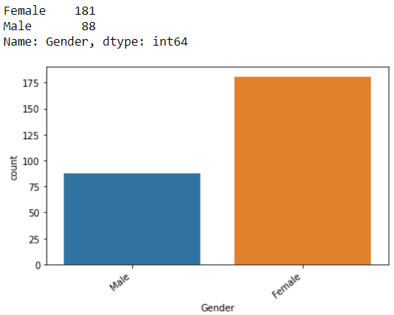
Interests of male vs female

Slide 8
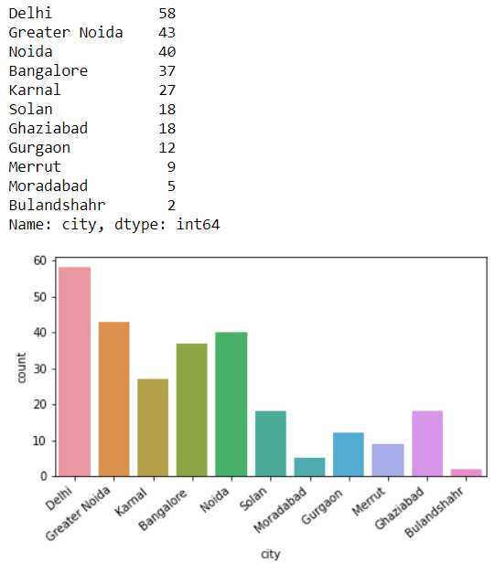
Metro vs Non-Metro users

Slide 9
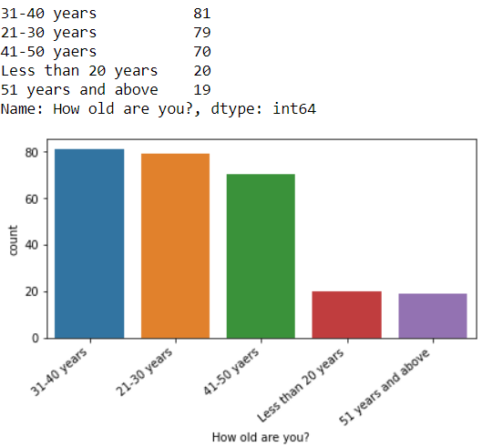
Young and Elderly

Slide 10
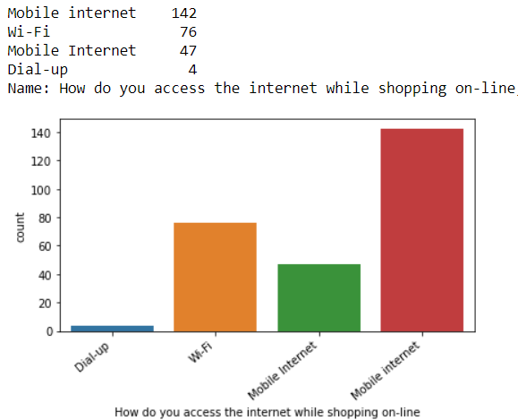
Smart mobile devices impact

Slide 11
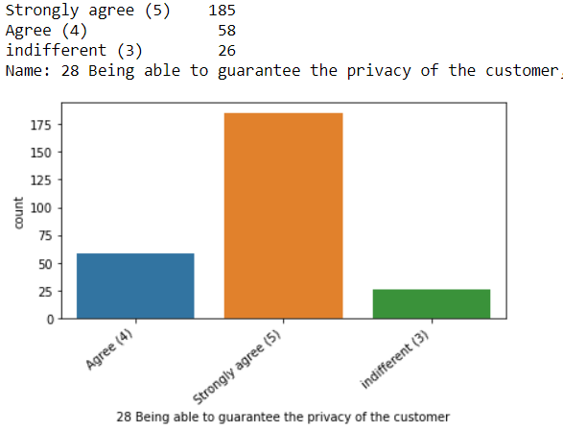
Guaranteed Privacy

Slide 12
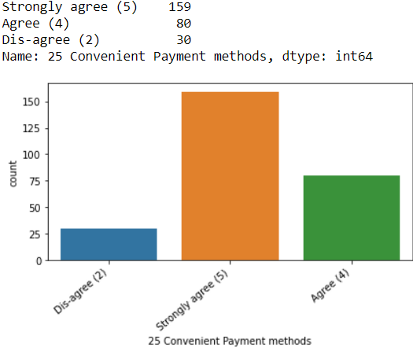
Secure and convenient payment options

Slide 13
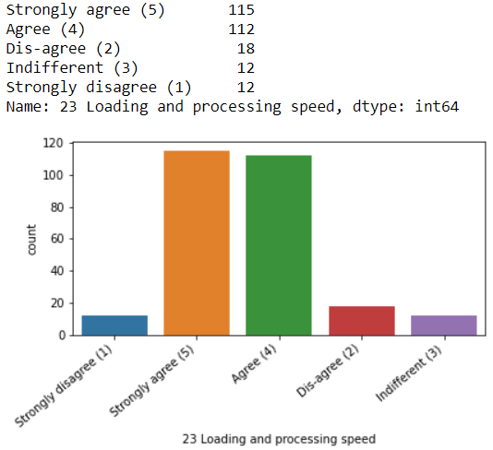
Website’s Speed

Slide 14
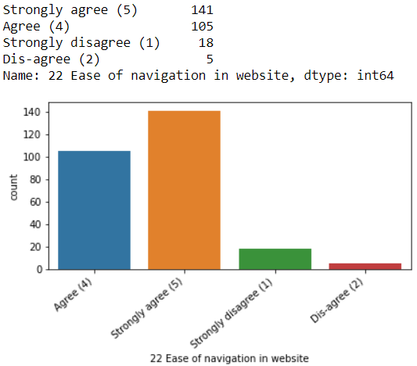
Easy and user-friendly navigations

Slide 15
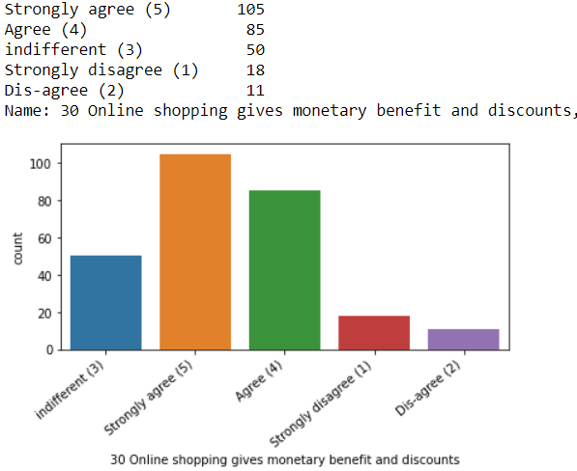
Discounts and loyalty bonus

Slide 16
The Conclusion…..

Slide 17
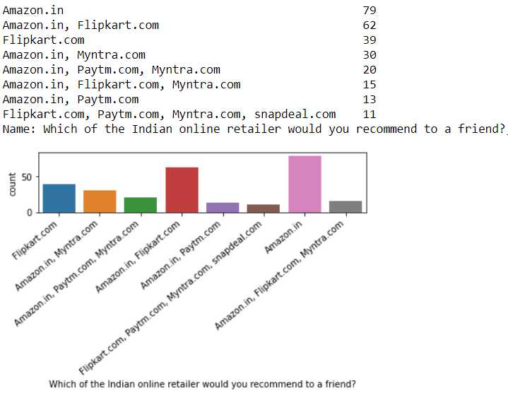
Amazon.in is most preferred

Slide 18
The Conclusion…..
Gender, Age, Metro Cities, Smart phone, better internet infrastructure, Customer rating are few of the factors which helps online shopping business to create an impact among their customers.
The business which has focus on the ease of navigation in their app, better site performance, faster deliveries, and discounts got an edge in this online world.
Besides, many customers do prefer secure and easy payment method, and their privacy.
Amazon show their leadership in these features and able to influence customer more than any other online business platform.

Slide 19
Thank You
Submitted by:
Ujjwal Pratik

